Slide 1
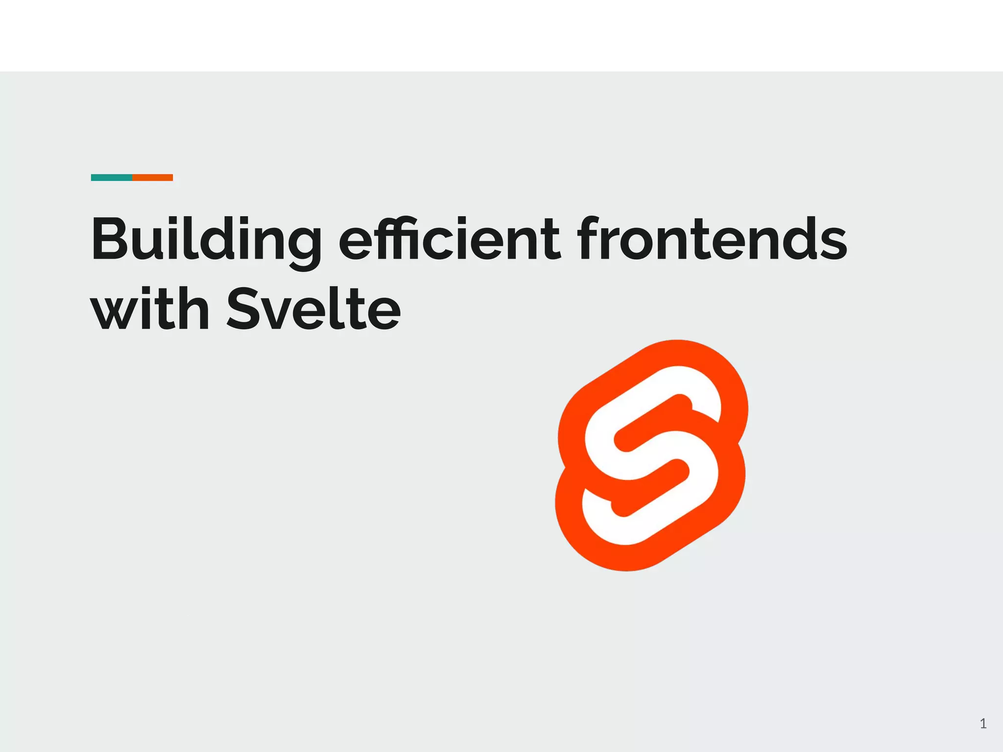

Slide 2
Agenda
What is Svelte?
Why choose Svelte?
Key features of Svelte
Getting started with Svelte
Svelte ecosystem and community
Svelte vs. other frameworks
Svelte success stories
Q&A

Slide 3
What is Svelte?
A modern JavaScript framework for building user interfaces
Emphasizes simplicity and performance
Reactive approach: Updates the DOM directly instead of using a virtual DOM

Slide 4
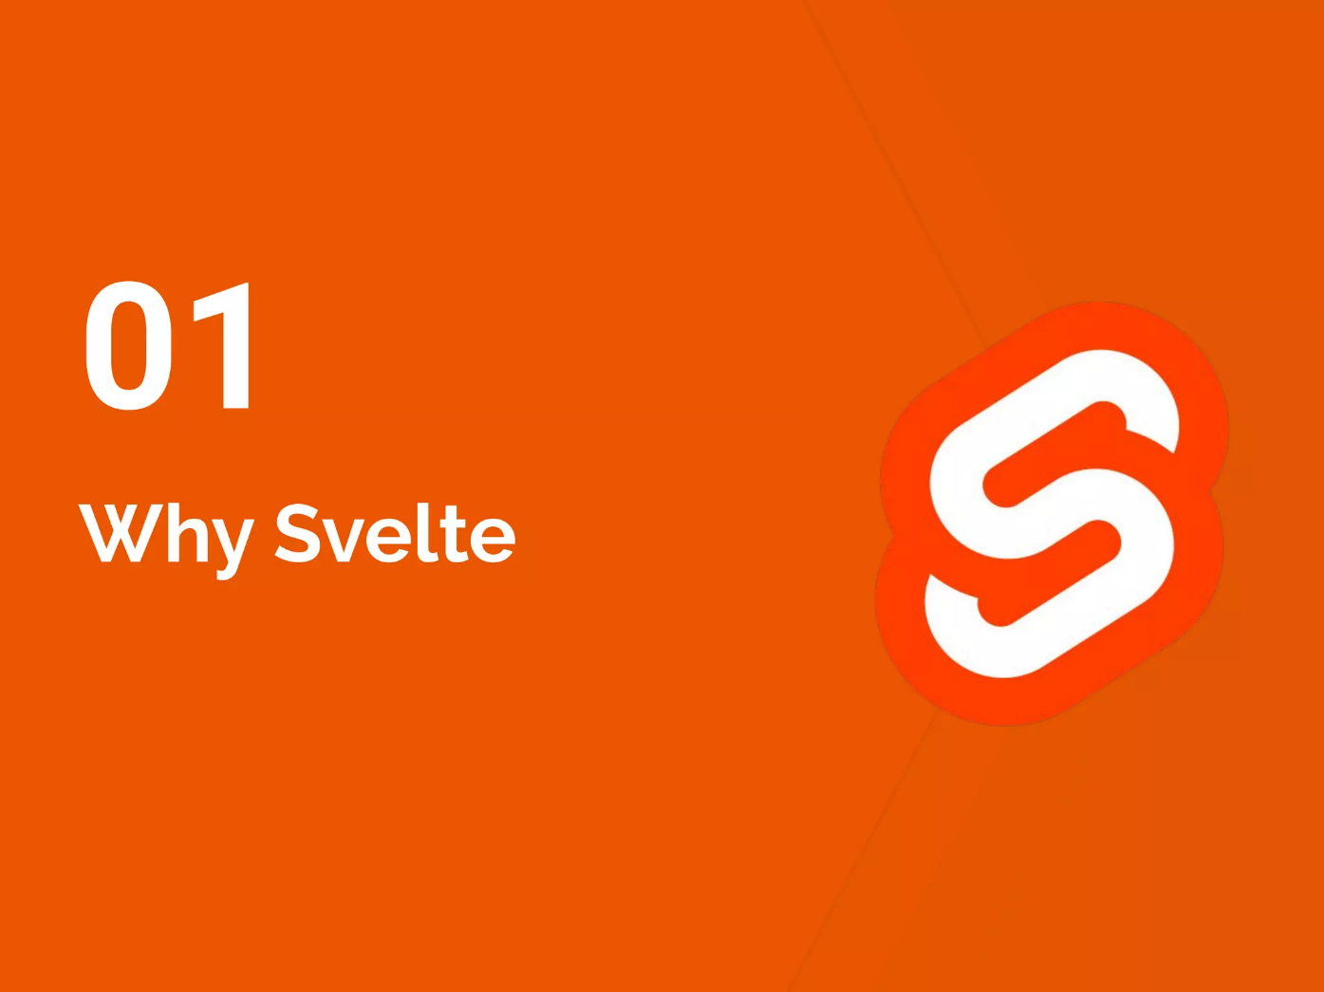

Slide 5
Why svelte :-
Simplicity: No complex abstractions or build steps
Performance: Generates highly optimized and efficient code
Small bundle size: Delivering fast-loading applications
Framework size: Only a few kilobytes in size
Smooth animations and transitions

Slide 6
Key features of Svelte:
Reactive: Automatic updates to the DOM based on data changes
Components: Encapsulated reusable building blocks
Props and state management
Templating : Declarative syntax similar to HTML
CSS encapsulation: Scoped styles within components
Animation and transition support
Routing: Easy navigation within the application

Slide 7
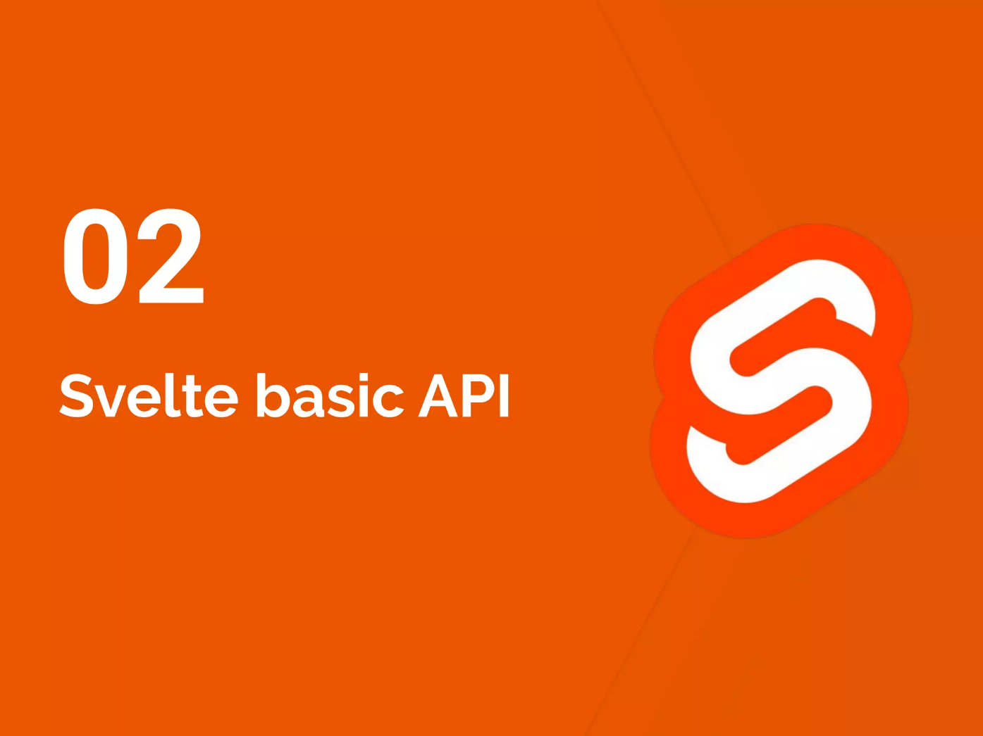

Slide 8
Getting started with Svelte:
Installation and setup: npm/yarn commands:-
npm create svelte@latest myapp
cd myapp
npm install
npm run dev
Svelte REPL: Online playground to experiment with Svelte code
Project structure: Single file components (.svelte files)

Slide 9
Documentation
Official website: Documentation, tutorials, and examples
You can visite :-
https://svelte.dev/docs

Slide 10
Svelte vs. other frameworks:
1- Library size
2- Library speed
3- Amout of Code

Slide 11
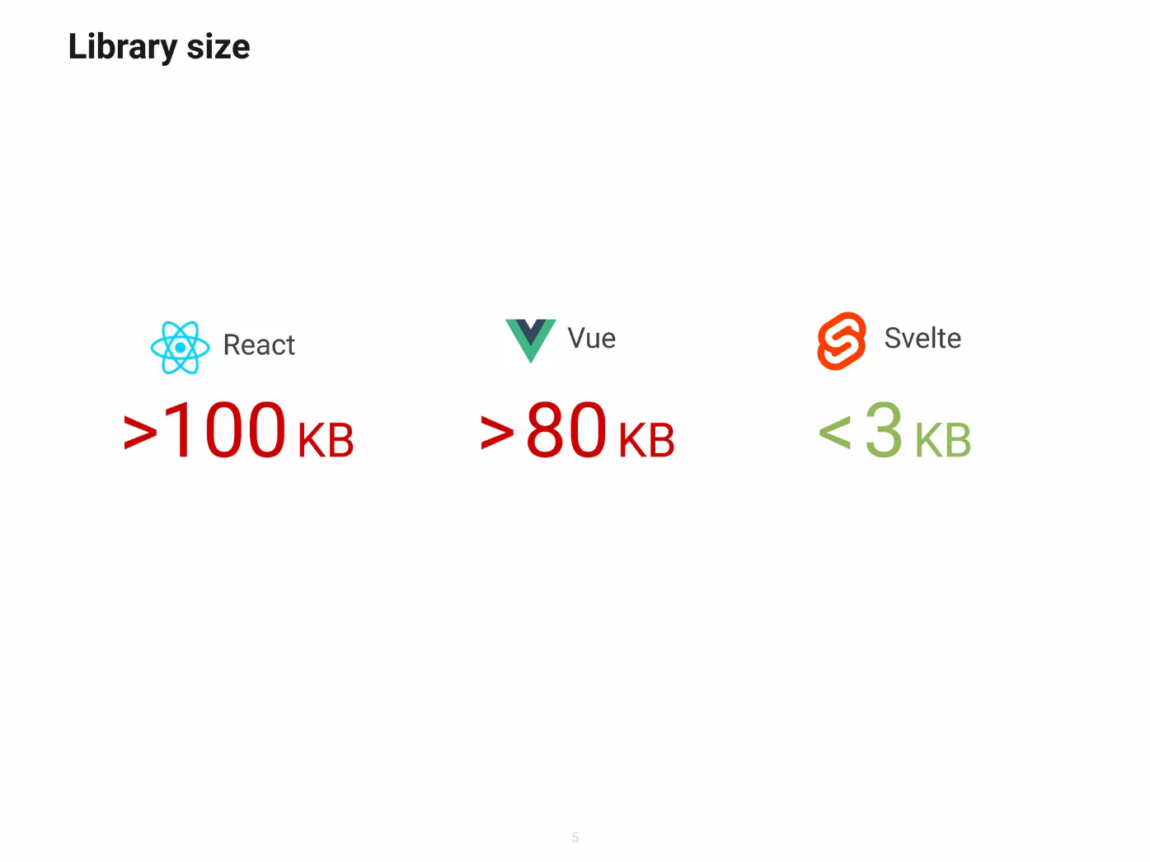

Slide 12
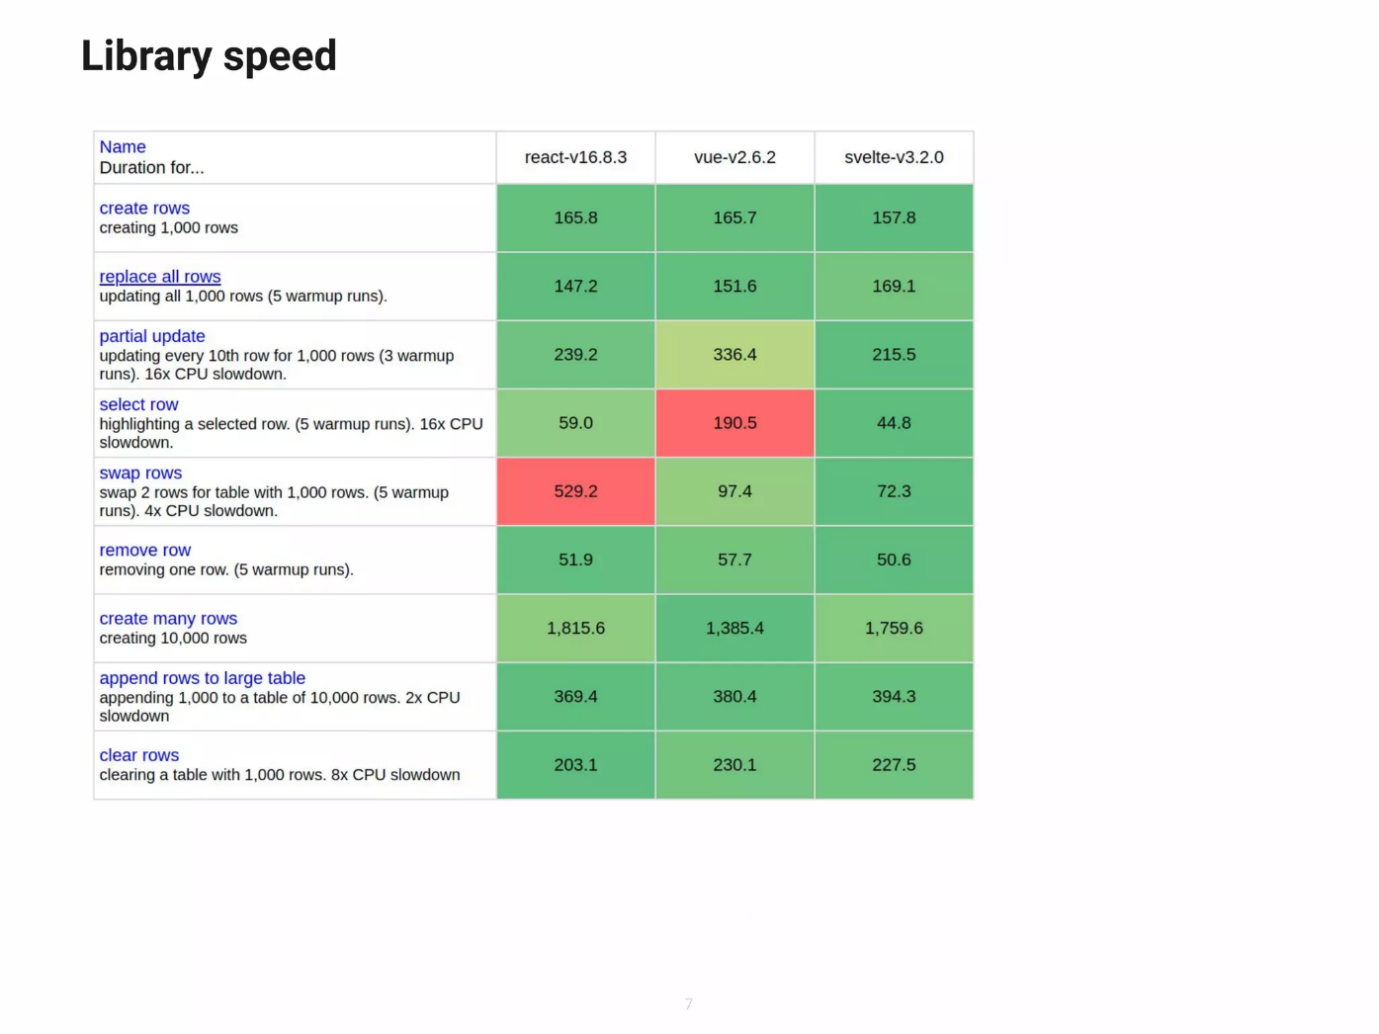

Slide 13
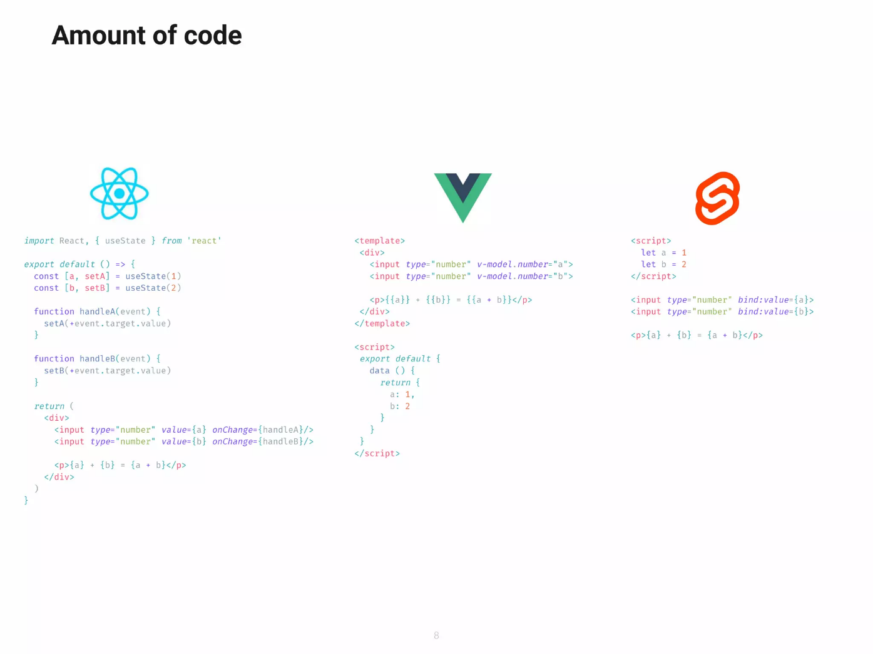

Slide 14


Who use svelte:

Slide 15
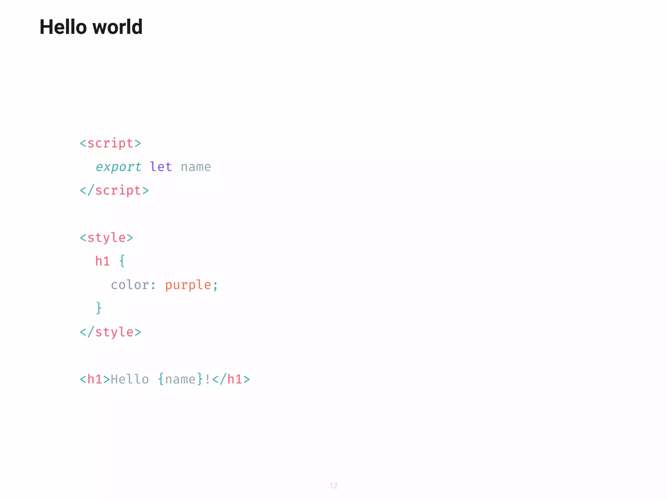

Slide 16
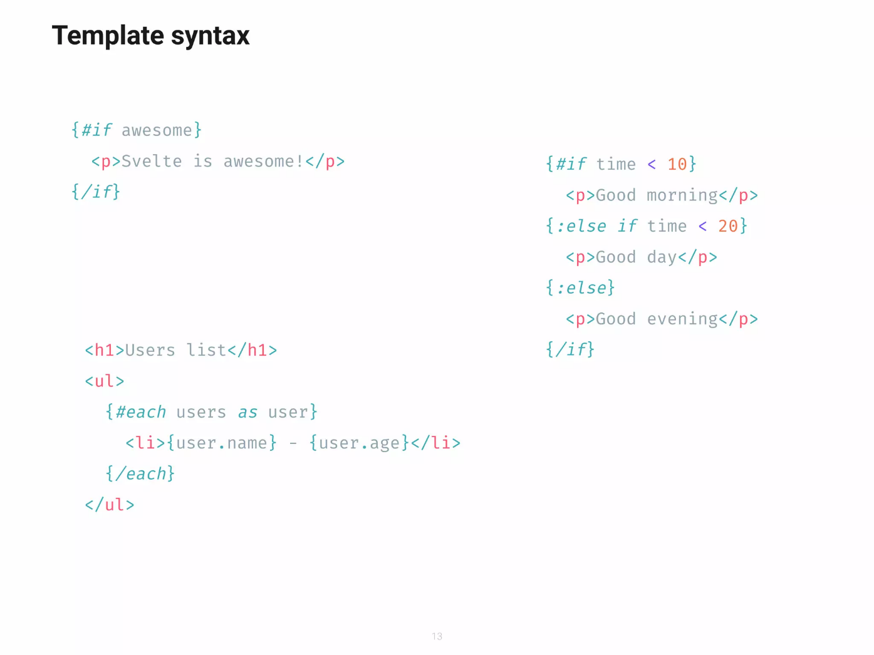

Slide 17
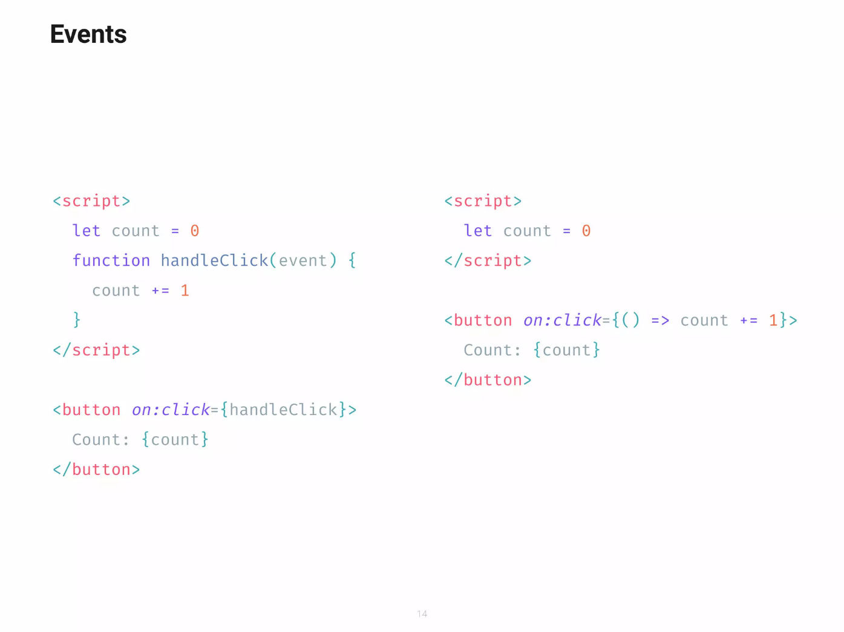

Slide 18
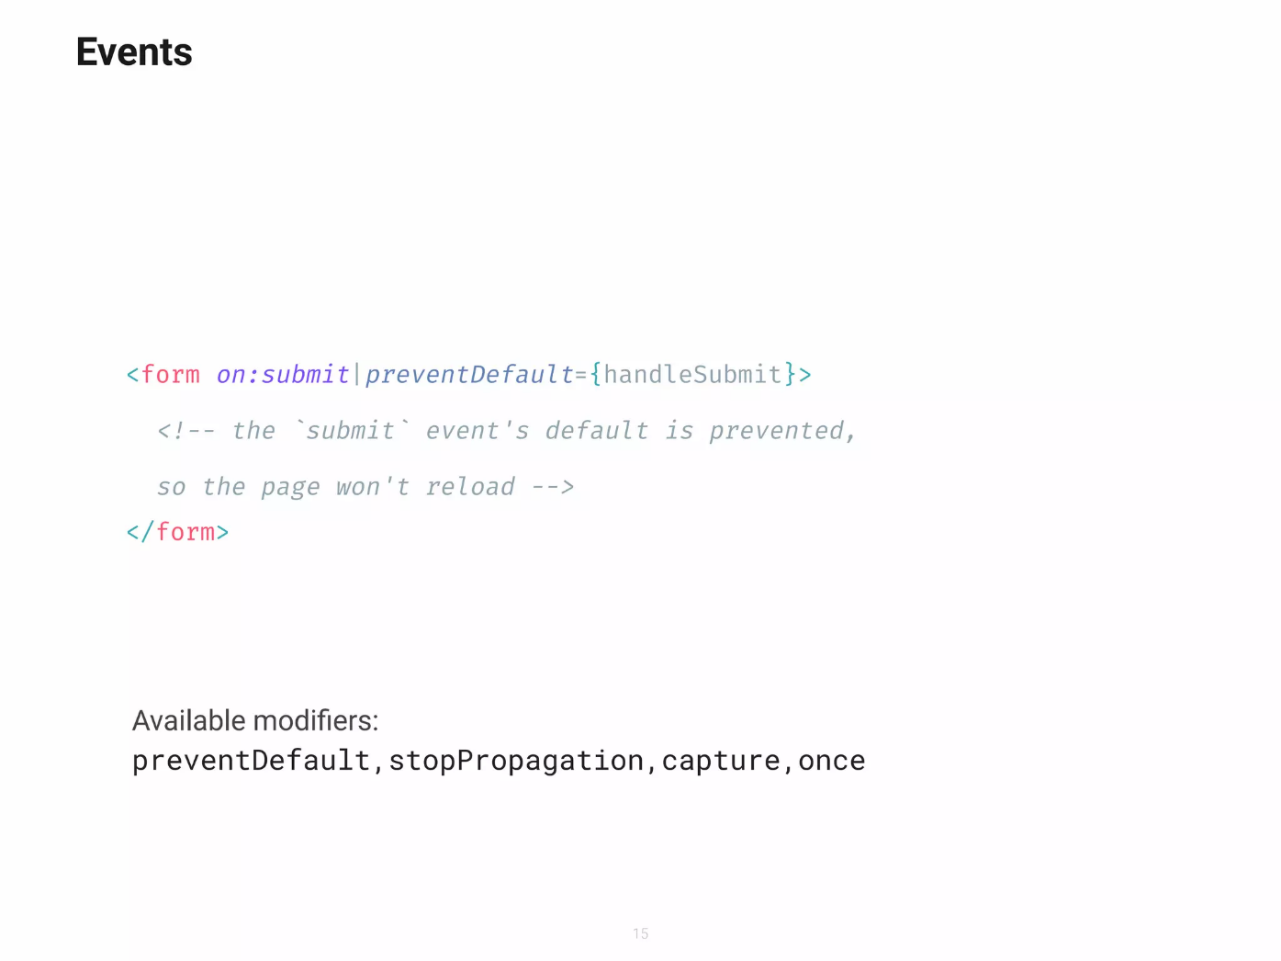

Slide 19
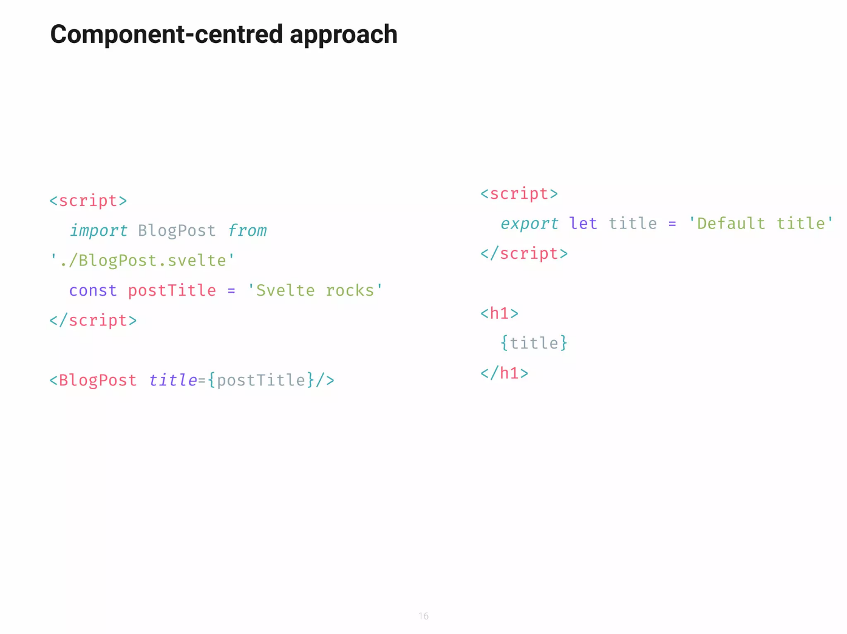

Slide 20
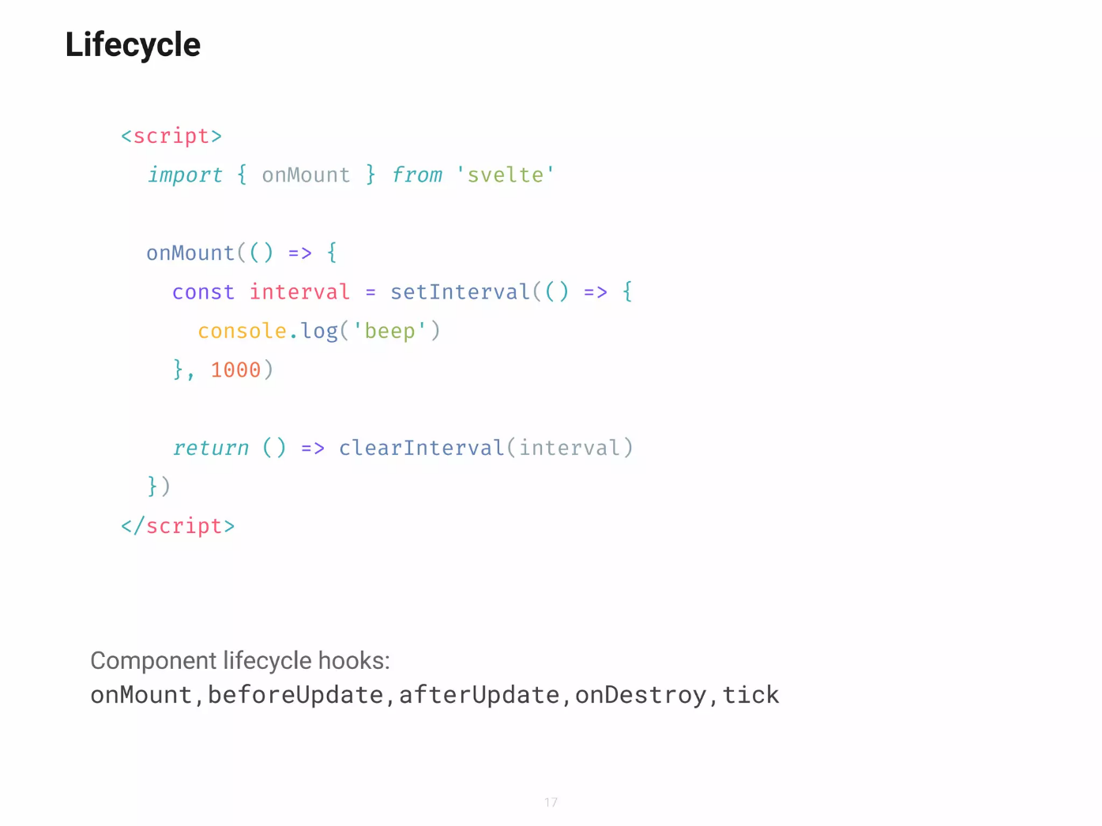

Slide 21
Recap
Conclusion:
Recap the main points discussed
Encourage further exploration and experimentation with Svelte
Thank the audience for their attention

Slide 22


